Slide 1
Classification
Unit 10

Slide 2
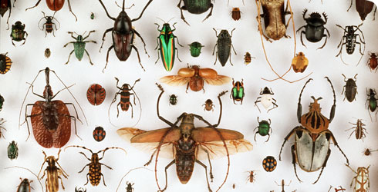
Key Concept
Taxonomy is the science of naming and classifying organisms.

Slide 3
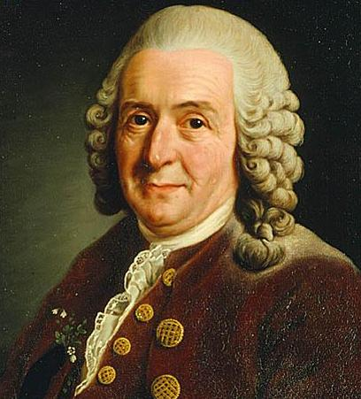
Carl Linnaeus
In the 1700s, Linnaeus developed a system for naming and classifying organisms.
(We still use his system with a few changes/additions.)

Slide 4
Linnaean System
There are two things that make the Linnaean system very successful.
Taxonomic groups
Binomial nomenclature

Slide 5
Taxonomic Groups
A taxon (pl. taxa) is a group of organisms in the classification system.

Slide 6
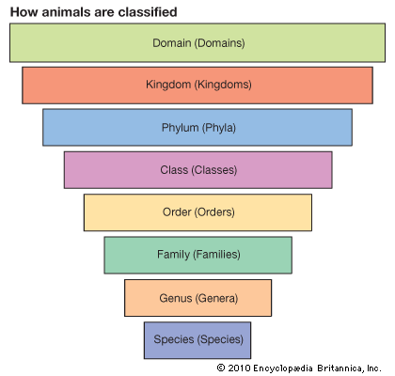
Taxonomic Groups
The system we use today includes 8 taxa: domain, kingdom, phylum, class, order, family, genus, species.

Slide 7
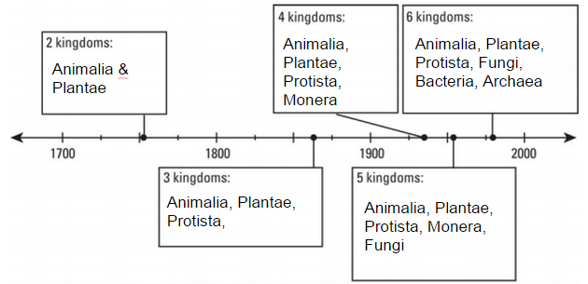
Taxonomic Groups
This system has changed a lot over the years! Domains were added in 1990.

Slide 8
Taxonomic Groups
The domain is the most general taxon, and species is the most specific.

Slide 9
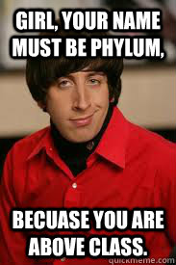
Taxonomic Groups
Let’s practice.
Several orders make up a ______________?
A family is made up of several __________?
Class
Genera

Slide 10
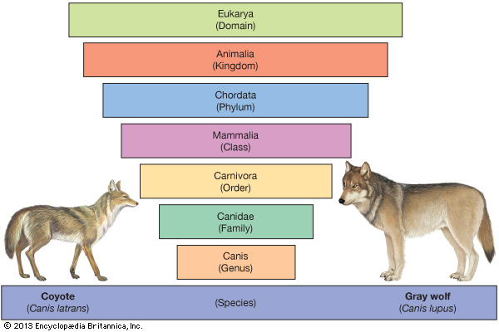
Taxonomic Groups

Slide 11
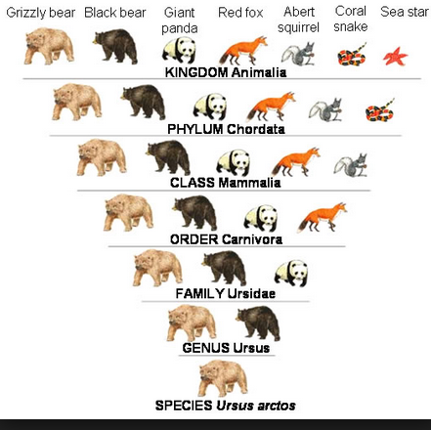
Taxonomic Groups

Slide 12
Taxonomic Groups
You will want to have these groups memorized in order. Let’s Practice!
Dreamy King Phillip Came Over For Good Soup
Domain Kingdom Phylum Class Order Family Genus Species

Slide 13
Some Funny Ones...
Dr. King Preached Courageously On Freakin Giant Snakes
Dumb Kids Playing Cards on Freeway Get Smashed
Dudes Keeping Precious Creatures Organized For Grumpy Scientists
Darn, Kevin’s Poor Cow Only Feels Good Sometimes

Slide 14
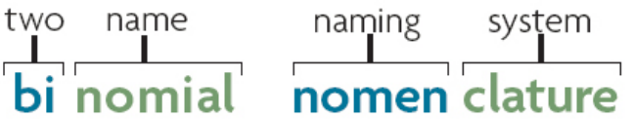
Binomial Nomenclature
Binomial nomenclature is an international system for naming organisms.

Slide 15
Binomial Nomenclature
Scientific names follow certain rules.
Latin or Greek
Genus (capitalized) and species (lowercase)
Italics or underlined

Slide 16


Binomial Nomenclature
The scientific name of humans is Homo sapiens or Homo sapiens.
Latin or Greek
Genus (capitalized) and species (lowercase)
Italics or underlined

Slide 17
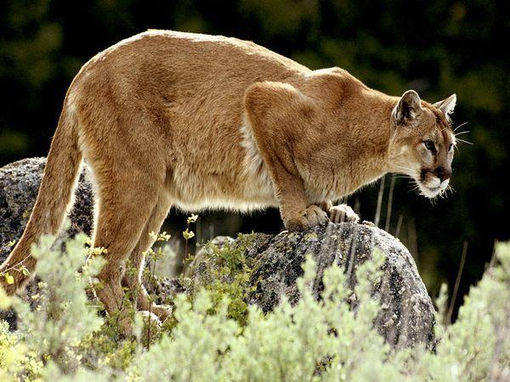
So why is this all important?
What do you call this animal?

Slide 18
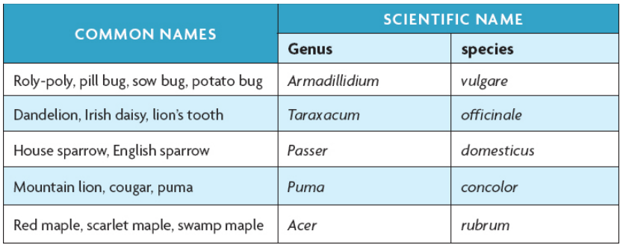
So why is this all important?
Scientific names help scientists communicate.

Slide 19
So why is this all important?
We don’t even know how many species there are on Earth! It is estimated that there are 8.7 million eukaryotic species on Earth, but many scientists are skeptical about that number.
Even so, classifying 8.7 million things requires serious organization!

Slide 20
Limitations of Linneaus’s system
Focused on physical similarities .
Physical similarities are not always a result of a close relationship between species.
What other information could scientists use today to classify organisms?

Slide 21
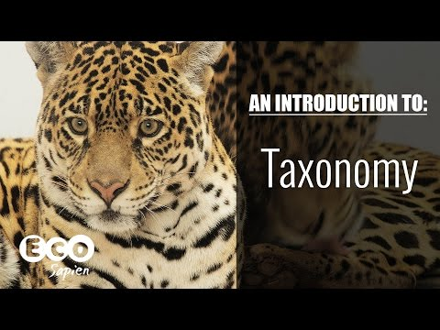
Video

Slide 22
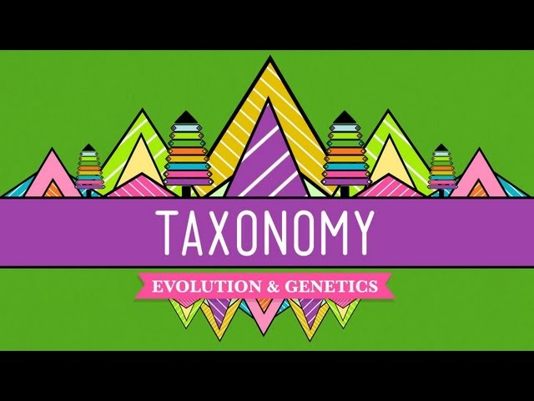
Crash Course: Taxonomy
Watch until 6:00.

Slide 23


Slide 24
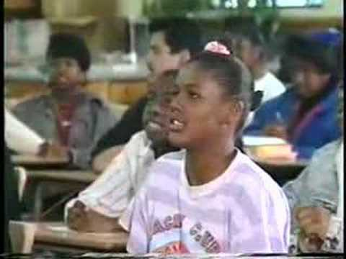
Classification Rap

